Slide 1
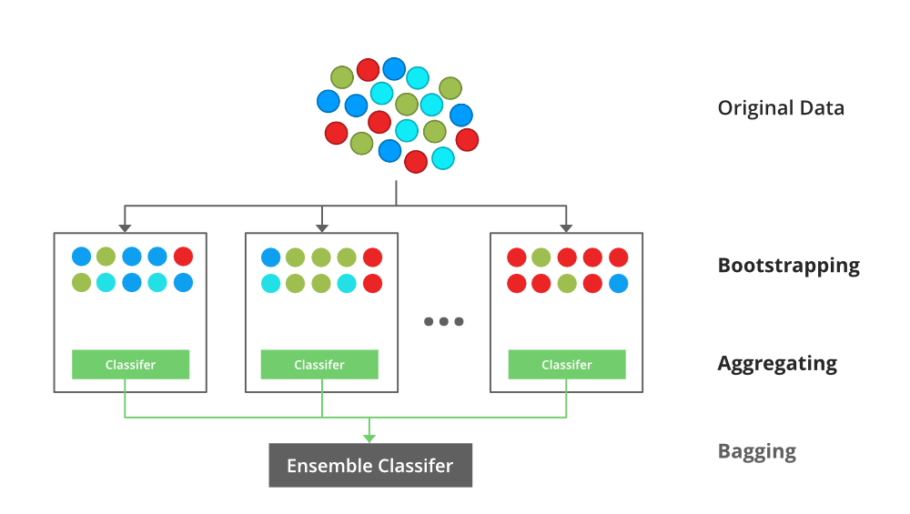
XG Boost Algorithm
XG Boost is stands for Extreme Gradient Boosting.
Boosting technique is multiple weak learners (decision trees) are trained sequentially.
Each tree corrects the errors made by the previous trees.

Slide 2
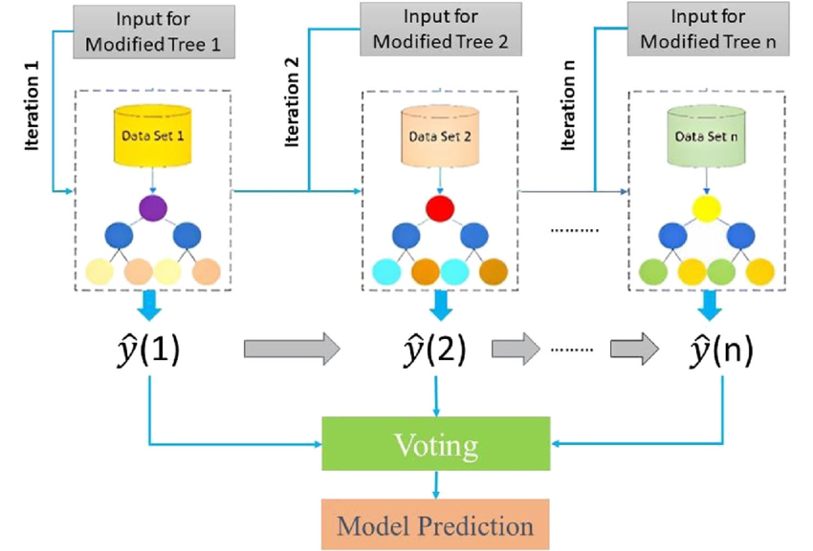
XG Boost Algorithm
Gradient Boosting Decision Trees (GBDT) algorithm designed for speed and efficiency.

Slide 3
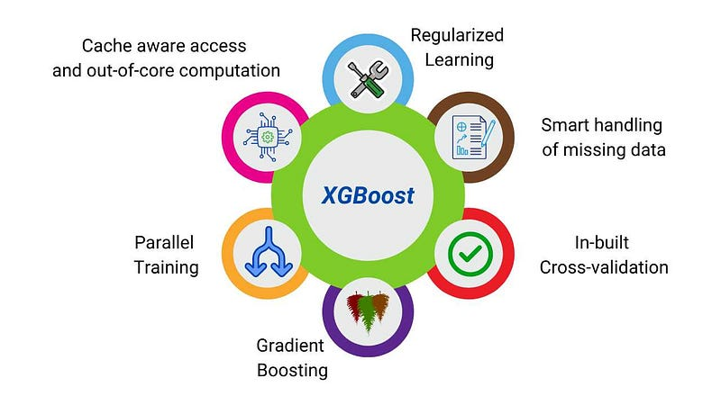
Key Features of XG Boost
Key Features:
Regularization (L1 & L2) to prevent overfitting
Parallel and distributed computing for faster training
Handles missing values automatically
Optimized for tree-based models with efficient memory usage

Slide 4
How Does XGBoost Work?
Initialize Predictions: Start with an initial guess (e.g., mean value for regression or equal probability for classification).
Compute Residuals (Errors): Calculate the difference between the actual and predicted values.
Train a Weak Learner (Tree): A decision tree is trained to minimize the residual errors.
Update Predictions: The new predictions are made by adding the new tree’s output to the previous prediction.
Repeat the Process: More trees are added iteratively until a stopping condition is met (e.g., number of trees, early stopping).
Final Prediction:
Fm(x)=Fm−1(x)+η×Tm(x)
Fm(x) = final prediction after m trees
Fm−1(x)F_{m-1}(x)Fm−1​(x) = previous prediction
η= learning rate
Tm​(x) = new decision tree prediction

